Slide 1
WELCOME TO MY PRESENTATION

Slide 2

Md Shohel Rana
Department of History
University of Barishal

Slide 3
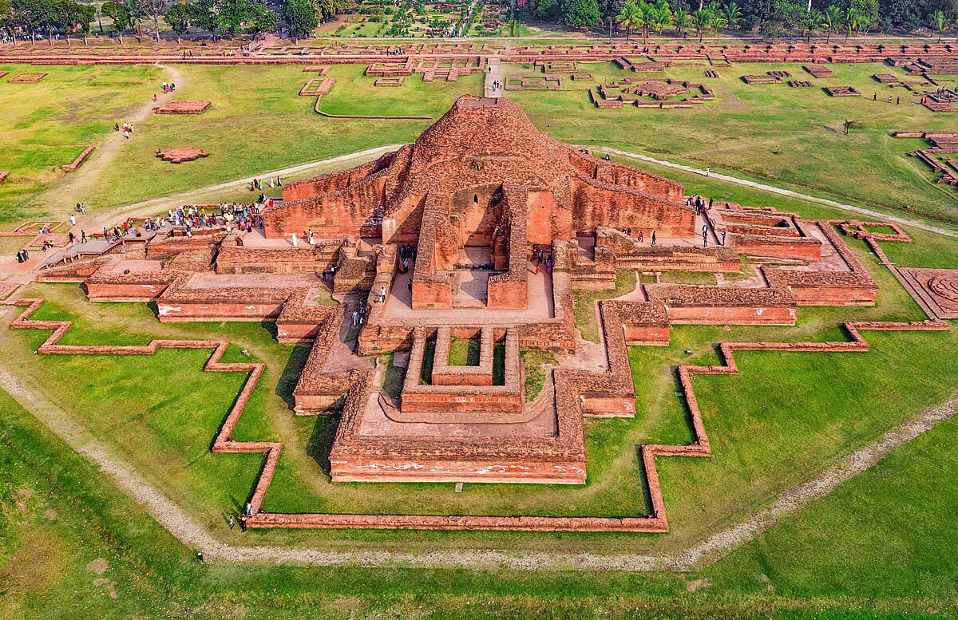
Report Name:
“Cultural Heritage and Urbanization: A Comparative Study of Sompur Mahavihara”

Slide 4
Introduction
Sompur Mahavihara, a UNESCO World Heritage site located in Paharpur, Bangladesh, stands as one of the most significant archaeological and cultural monuments in South Asia. This ancient Buddhist monastery, constructed in the 8th century during the Pala Dynasty, showcases an exquisite fusion of architectural brilliance and religious significance. However, like many historic sites, Sompur Mahavihara faces the pressures of modern urbanization, with nearby development threatening its preservation.
This study explores the intricate balance between cultural heritage conservation and the demands of urban expansion, comparing Sompur Mahavihara's challenges with those faced by other heritage sites globally. Through this comparative lens, the research underscores the critical need for sustainable urban planning that safeguards such irreplaceable cultural legacies while accommodating modern growth.

Slide 5
Historical Context of Sompur Mahavihara
Sompur Mahavihara, built in the late 8th century by the Pala Emperor Dharmapala, is one of the largest and most renowned Buddhist monasteries of ancient India. Located in present-day Paharpur, Bangladesh, it became a major center of Mahayana Buddhism and a hub for religious, cultural, and educational activities. The monastery's architectural grandeur, characterized by its massive cruciform structure and terracotta ornamentation, reflects the height of Pala Dynasty craftsmanship.
As a center for scholars and monks from across Asia, Sompur Mahavihara contributed significantly to the spread of Buddhism, influencing monastic architecture in regions as far as Southeast Asia and Tibet. However, with the decline of Buddhism in the Indian subcontinent and the even
tual fall of the Pala Dynasty, the site was abandoned and gradually fell into ruin, only to be rediscovered in modern archaeological excavations. Its enduring legacy lies in its architectural innovations and its role in promoting Buddhist learning and culture across Asia.

Slide 6
Row Labels | Sum of Discovery Year
Architectural | 23349
Artifact | 15658
Artistic | 1980
Inscription | 1940
Sculpture | 19500
Grand Total | 62427

Slide 7
Row Labels | Count of Element Name
10th Century | 3
8th Century | 5
9th Century | 7
Gupta Era | 5
Pala Dynasty | 12
Grand Total | 32

Slide 8
Row Labels | Sum of Excavation Duration (months)
Archaeological Society | 6
Collaborative Effort | 10
Global Archaeological Team | 8
Indian Archaeology Dept. | 12
International Team | 8
Local Archaeological Team | 4
National Archaeological Society | 5
Grand Total | 53

Slide 9
Row Labels | Sum of Discovery Year
Brick Stupa Base | 1960
Bronze Bell | 1965
Bronze Ritual Vessels | 1952
Carved Stone Lotus Pedestal | 1969
Clay Lamps | 1953
Decorative Arches | 1965
Decorative Tiles | 1945
Earthenware Pots | 1975
Frescoes | 1980
Main Stupa | 1920
Metal Buddha Statue | 1950
Monastery Boundary Wall | 1968
Monastic Cells | 1925
Ornamental Pillars | 1928
Prayer Hall Ruins | 1930
Ritual Offering Table | 1958
Stone Altar | 1960
Stone Buddha Statues | 1940
Stone Carvings | 1955

Slide 10
Row Labels | Sum of Year | Sum of Duration of Stay (days)
Australia | 2004 | 1
Canada | 1974 | 5
Egypt | 2024 | 3
India | 3938 | 4
Japan | 1944 | 3
Pakistan | 1964 | 2
South Korea | 2014 | 4
UK | 1934 | 1
USA | 3918 | 4
Grand Total | 21714 | 27

Slide 11
Row Labels | Count of Era/Age
Brick | 4
Brick, Stone | 2
Bronze | 2
Clay | 2
Metal | 1
Paint, Brick | 1
Stone | 16
Terracotta | 4
Grand Total | 32

Slide 12
Row Labels | Sum of Year
Ahmed Khan | 1964
Clara Johnson | 1974
David Kim | 2014
Emily White | 2004
Fatima Begum | 1954
Hiroshi Tanaka | 1944
John Doe | 1924
Leila Ali | 2024
Mary Smith | 1934
Nikhil Sharma | 1984
Sarah Brown | 1994
Grand Total | 21714

Slide 13
Row Labels | Sum of Quantity of Artifacts
1924 | 50
1954 | 20
1974 | 15
1994 | 200
2004 | 5
2014 | 100
2024 | 10
Grand Total | 400

Slide 14
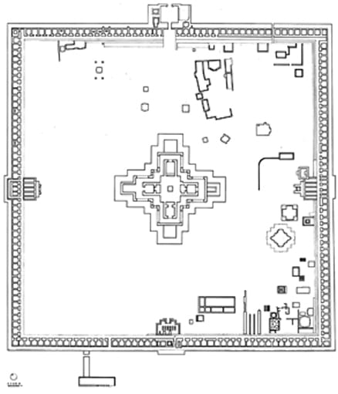
Architectural View
Layout and Design
Main Stupa
Monastic Cells
Intricate Carvings and Decorative Motifs
Natural Landscape Integration

Slide 15
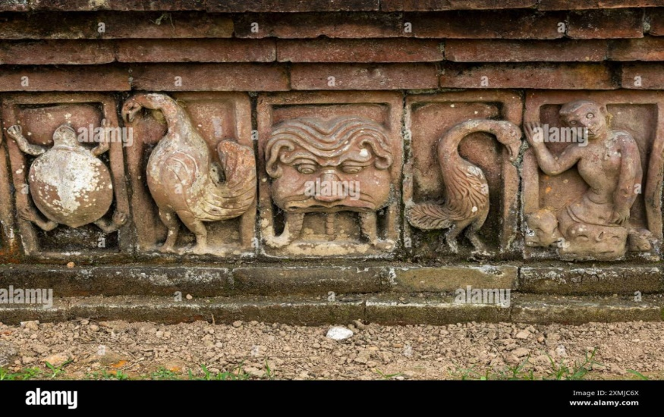
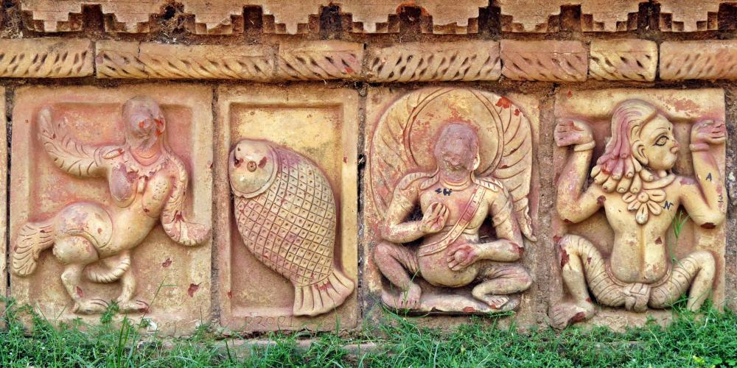
Archological Elements of Sompur Mahavihara:
Central Stupa (Main Temple)
Monastic Cells
Terracotta Plaques
Sculptural Reliefs
Courtyard
Entrance Gateway
Brickwork Architecture
Water Drainage System
Copper Coin
Inscriptions

Slide 16
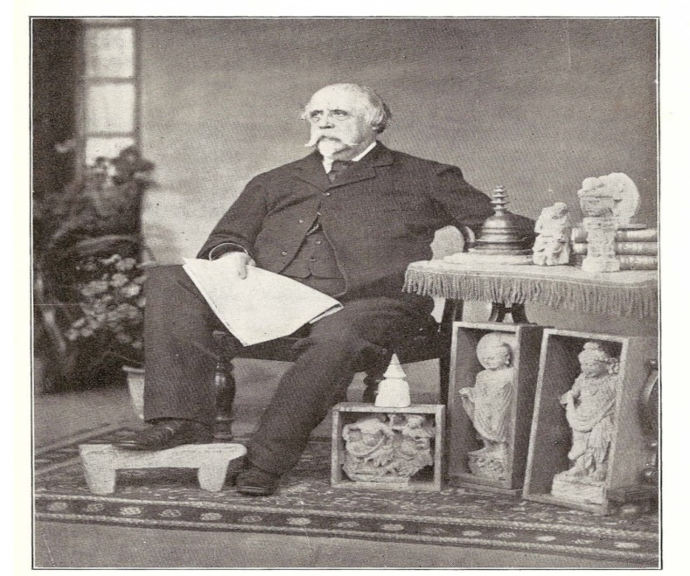
Excavators of Sompur Bihar
Excavators | Period of time
Sir Alexander Cunningham | 1879
K.N. Dikshit | 1923-1924
Nani Gopal Majumdar | 1930s
Debala Mitra | 1950s-1960s
Bangladesh Department of Archaeology | Post-1971
UNESCO Involvement | 1980s
Sir Alexander Cunningham (1814-1893)
Sir Alexander Cunningham was the First Excavator of Sompur Mahavhaira (1879)

Slide 17
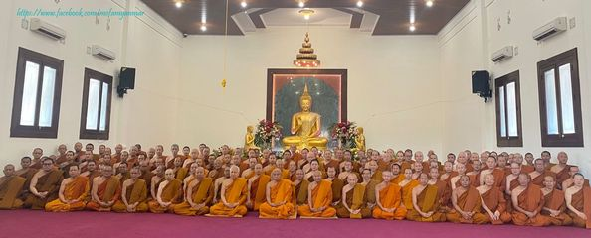
Sompur Mahavihara and Global Buddhism
Sompur Mahavihara, located in Bangladesh, is an 8th-century Buddhist monastery and UNESCO World Heritage Site. Built during the Pala Dynasty, it was a major center for Mahayana Buddhist learning, attracting scholars and monks from across Asia, including Tibet, China, and Southeast Asia. Its architectural design influenced Buddhist temples in Southeast Asia, and its terracotta art and sculptures reflected global Buddhist iconography. Sompur played a key role in the spread of Buddhism, linking it to the broader Pala network of monasteries and contributing to the transmission of Buddhist knowledge and culture globally

Slide 18
Strategies for Sustainable Preservation of Sompur Mahavihara
Sompur Mahavihara, as a UNESCO World Heritage Site, embodies the rich Buddhist heritage of Bangladesh and serves as a critical reminder of the region’s historical and cultural legacy. However, the challenges posed by urbanization, tourism, and environmental factors necessitate a strategic approach to ensure its sustainable preservation. The following strategies can be implemented to effectively safeguard this invaluable site while promoting its significance in contemporary society.
Comprehensive Urban Planning
Sustainable Tourism Management
Community Engagement and Education
Environmental Protection Measures
Funding and Resource Allocation
Interdisciplinary Collaboration
Research and Documentation

Slide 19
Conclusion
In conclusion, the comparative study of cultural heritage and urbanization at Sompur Mahavihara highlights the delicate balance between preserving a significant historical site and accommodating modern development. While urbanization poses challenges, such as the risk of encroachment and loss of authenticity, sustainable preservation strategies that involve community participation, careful planning, and heritage conservation can ensure the site's integrity. By integrating cultural heritage into urban planning, Sompur Mahavihara can serve as a model for how ancient landmarks can coexist with the demands of modern growth, preserving both cultural identity and urban progress.

Slide 20
The End
Thank You.

